Slide 1
Special Function Registers
A Closer Look

Slide 2
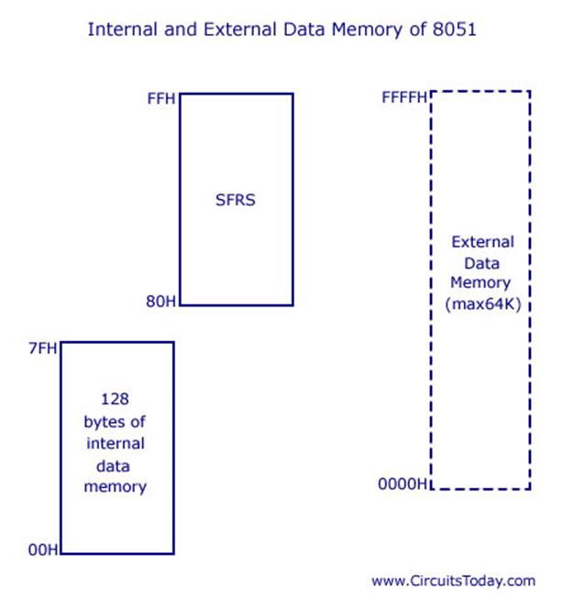

Slide 3
SFR MAP for 8051

Slide 4
FF | FE | FD | FC | FB | FA | F9 | F8 | F7 | F6 | F5 | F4 | F3 | F2 | F1 | F0
FF
EF
DF
CF
BF
AF
9F
8F
F0
E0
D0
C0
B0
A0
90
80
 |  |  |  |  |  |  |  |  |  |  |  |  |  |  | B
 |  |  |  |  |  |  |  |  |  |  |  |  |  |  | A
 |  |  |  |  |  |  |  |  |  |  |  |  |  |  | PSW
8F | 8E | 8D | 8C | 8B | 8A | 89 | 88 | 87 | 86 | 85 | 84 | 83 | 82 | 81 | 80

Slide 5
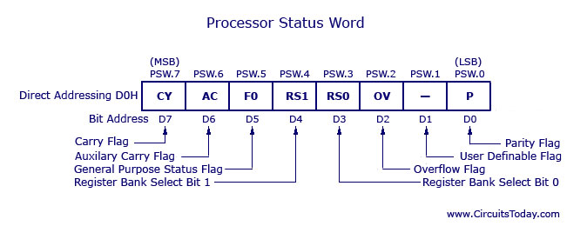

Slide 6
Bit Number | Bit Symbol | Direct Address | Name | Function
3 | RS0 | D3 | Register Bank Select Bit 0 | LSB of the register bank select bit
4 | RS1 | D4 | Register Bank Select Bit 1 | MSB of the register bank select bit

Slide 7
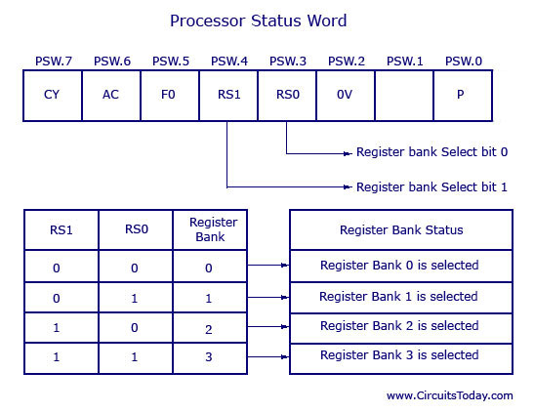

Slide 9
Bit Number | Bit Symbol | Direct Address | Name | Function
7 | Cy | D7 | Carry | Set: Data is coming out of the 7th bit Or Clear

Slide 11
Bit Number | Bit Symbol | Direct Address | Name | Function
0 | P | D0 | Parity | Set: Acc has odd number of 1s after operation Or Clear

Slide 13
Bit Number | Bit Symbol | Direct Address | Name | Function
1 | - | D1 |  | User Definable Bit
5 | F0 | D5 | Flag 0 | User Definable Flag

Slide 15
Bit Number | Bit Symbol | Direct Address | Name | Function
6 | AC | D6 | Auxiliary Flag | Set: Data is coming out of bit 3 to bit 4 of Acc during an arithmetic operation

Slide 17
Bit Number | Bit Symbol | Direct Address | Name | Function
2 | OV | D2 | Overflow | Set: Carry from 7 but not from 6 (or) Carry from 6 but not from 7

Slide 18
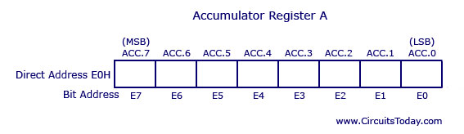

Slide 19
